Slide 1
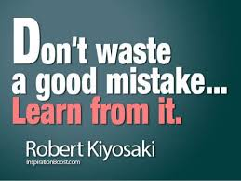
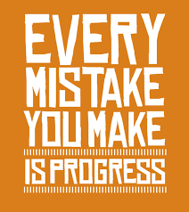
Starter Activity:
Identify and highlight the common mistakes made by students in their spreadsheets and database printouts.

Slide 2

Objective
Understand the common mistakes made by students in the practical element of the course.
Become the Mark Scheme and correct the Mistakes

Slide 3
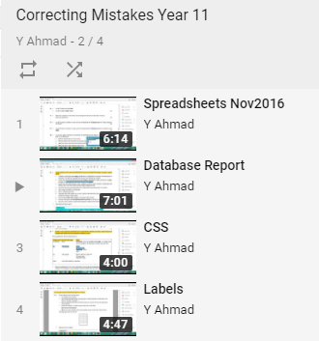
Task
Download the exam files containing the mistakes.
Go to the YouTube channel and watch the videos containing the mistakes.
In pairs identify the mistakes and correct them.
For the database task correct the query first and then edit the report including the labels.

Slide 4

Plenary
Review the following Spreadsheet papers:
November 2014
November 2015
November 2016
In green pen identify the more difficult aspects of the exam paper. Also identify questions which appeared for the first time. What advice would you pass onto students sitting this exam.

